Slide 1
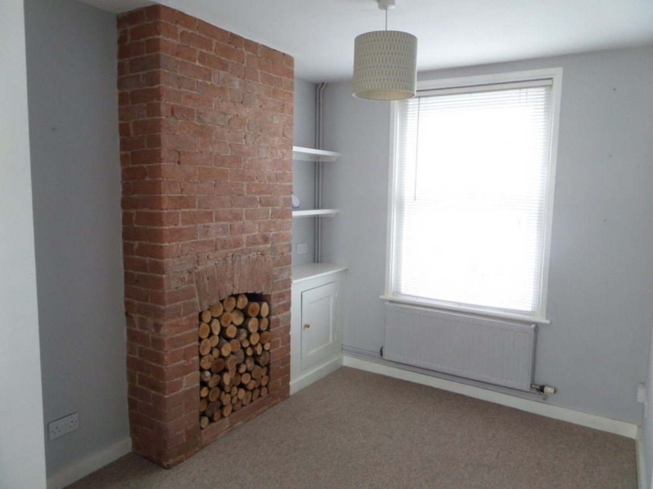
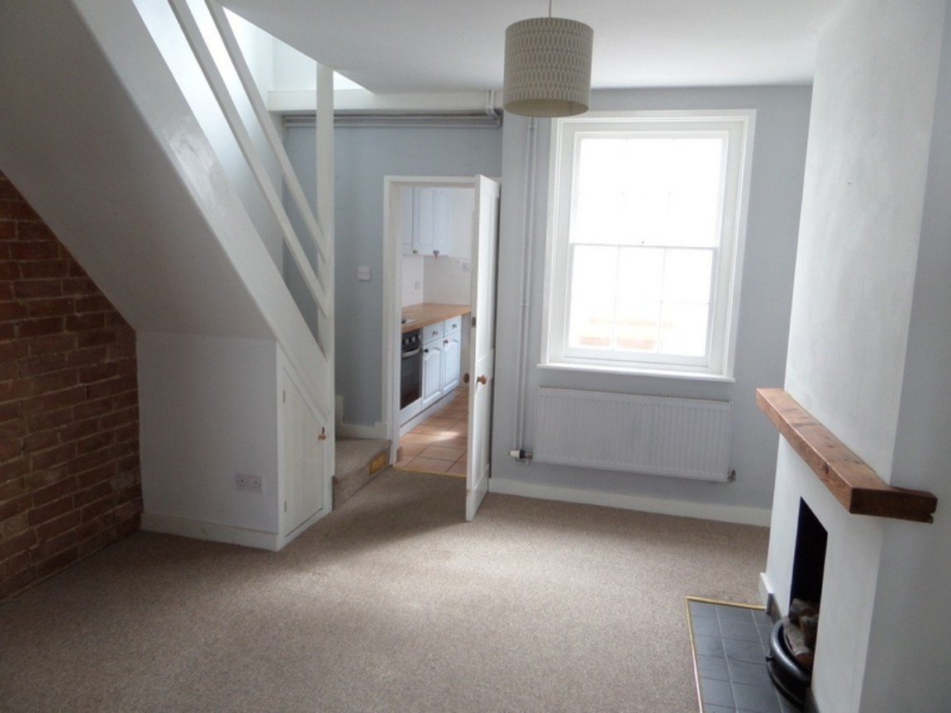
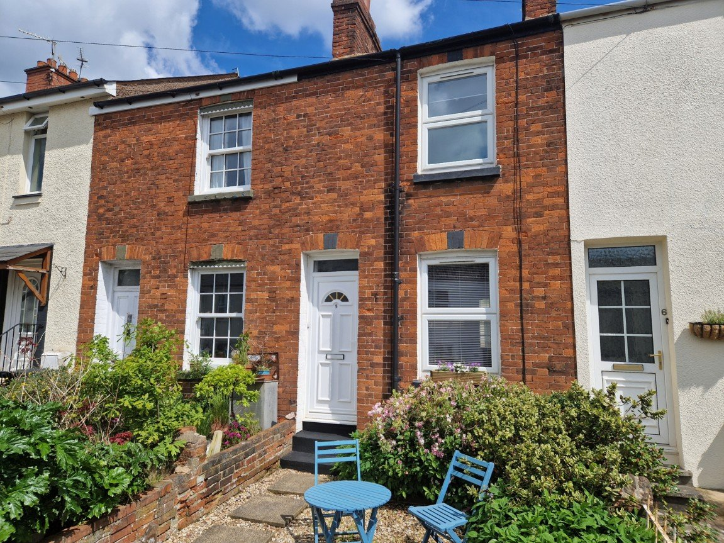
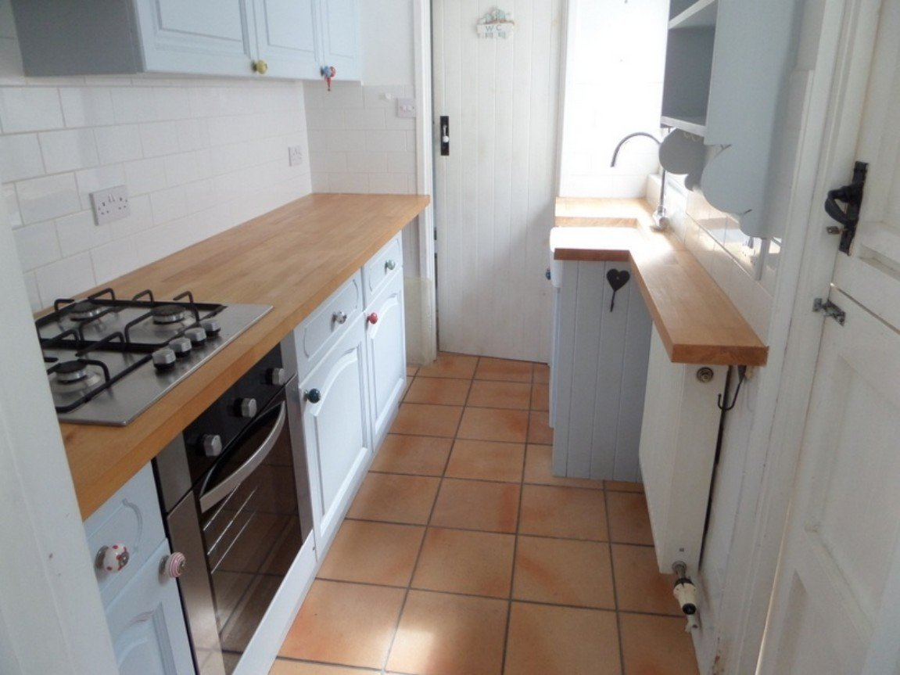
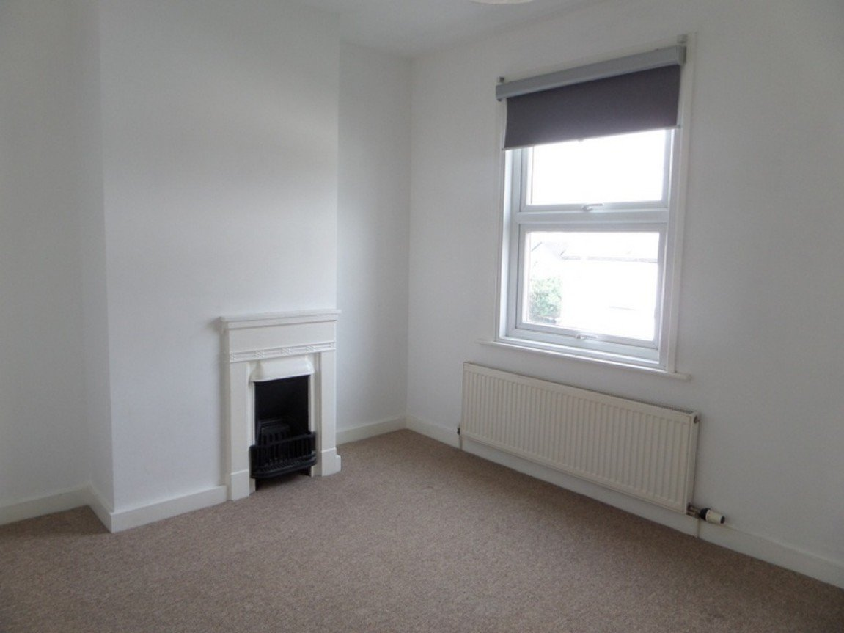
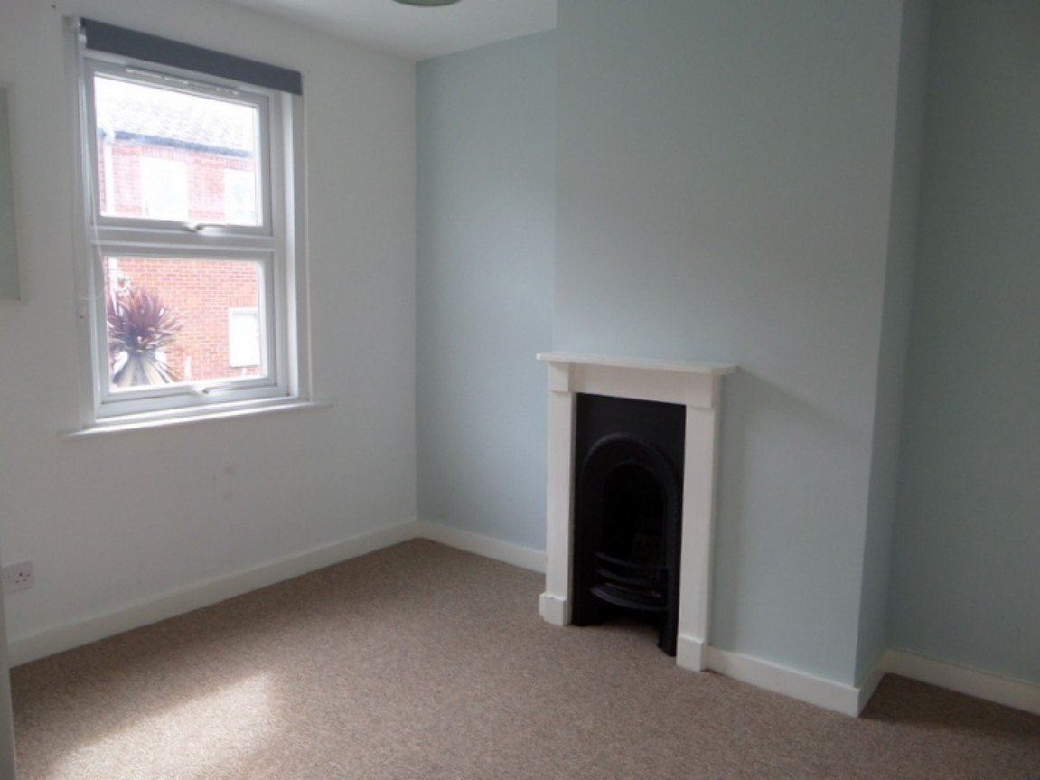
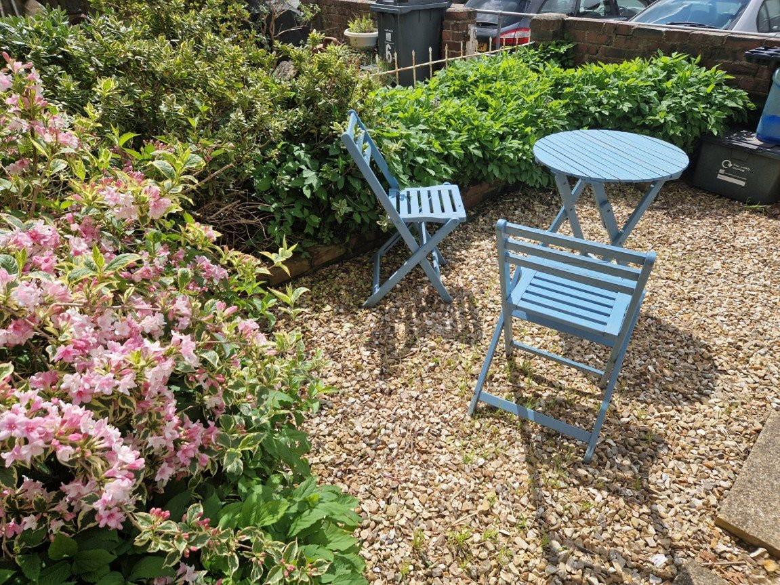
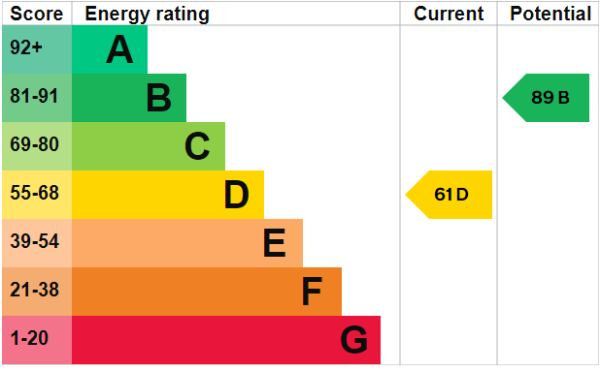
www.pennys.net
5 Helena Place, Exmouth, Devon,
EX8 1JG
PRICE £239,950
TENURE Freehold
A Mid-Terraced Two Double Bedroom House Enjoying A Central Yet
Tucked Away Location Close To The Heart Of Exmouth Town Centre
Offered For Sale With No Onward Chain
Reception Hall • Lounge • Dining Room •
Kitchen • Two First Floor Double Bedrooms • Bathroom/WC • Utility Room •
Gas Central Heating • Double Glazed Windows • Pleasant Front Garden •
Ideal Investment Opportunity Or First Time Purchase •
Pennys Estate Agents Limited for themselves and for the vendor of this property whose agents they are give notice that:- (1) These particulars do not constitute any part of an offer or a contract. (2) All statements contained in these particulars are made without responsibility on the part of Pennys Estate Agents Limited. (3) None of the statements contained in these particulars are to be relied upon as a statement or representation of fact. (4) Any intending purchaser must satisfy himself/herself by inspection or otherwise as to the correctness of each of the statements contained in these particulars. (5) The vendor does not make or give and neither do Pennys Estate Agents Limited nor any person in their employment has any authority to make or give any representation or warranty whatever in relation to this property.
PENNYS ESTATE AGENTS
2 Rolle House, Rolle Street, Exmouth, Devon, EX8 2SN
Tel: 01395 264111 EMail: help@pennys.net

Slide 2
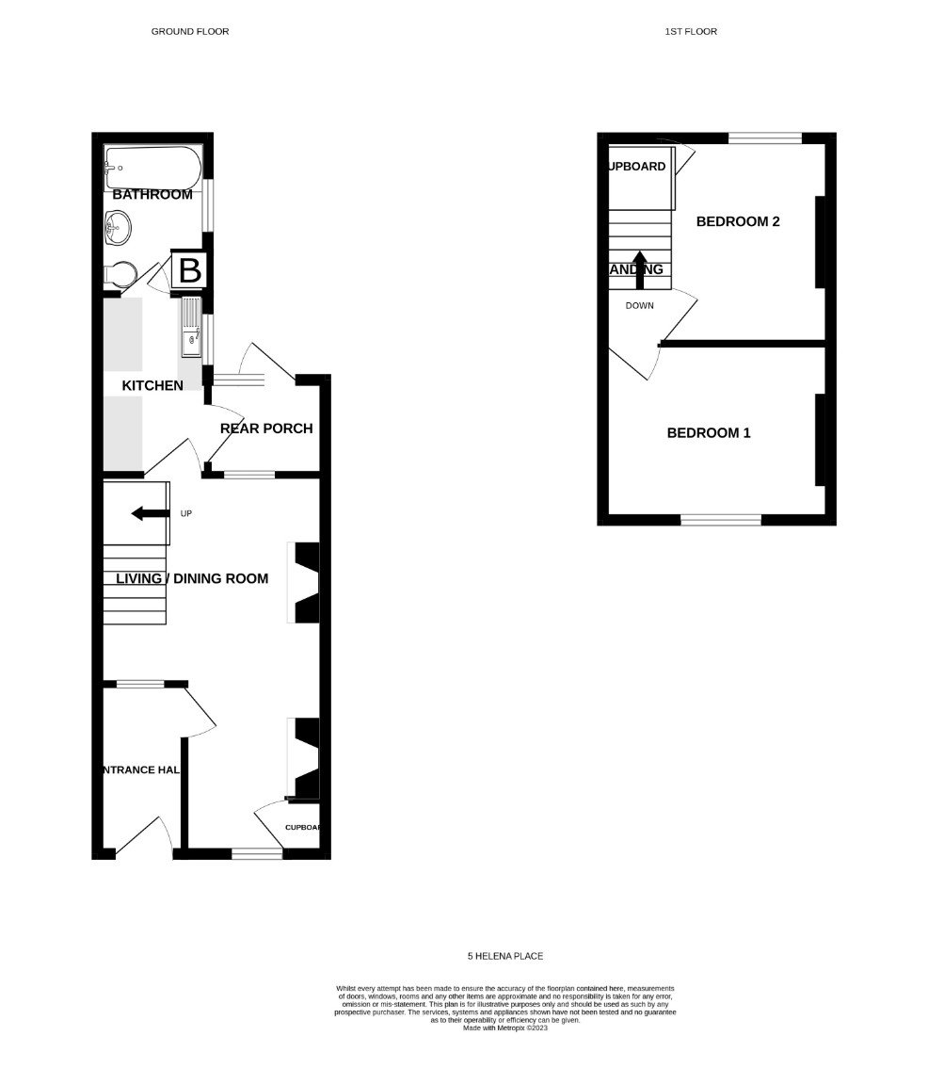
5 Helena Place Exmouth, Devon, EX8 1JG
THE ACCOMMODATION COMPRISES: uPVC double glazed entrance door giving access to:
ENTRANCE LOBBY: Electric meter; electric consumer unit; borrowed light window from the dining room; door to:
LOUNGE: - 2.62m x 2.49m (8'7" x 8'2") A bright room with uPVC double glazed window to front aspect; radiator; telephone point; feature exposed brick fireplace and chimney breast; fitted cupboard and shelving in wall recess; square opening leading through to:
DINING ROOM: - 3.51m x 3.2m (11'6" x 10'6") into wall recesses. uPVC double glazed window to rear aspect; radiator; feature fireplace with cast iron grate, tiled hearth and wood floating mantle; stairs rising to the first floor with understairs storage cupboard; door leading to the:
KITCHEN: - 2.72m x 1.63m (8'11" x 5'4") Fitted with a range of butchers block work top surfaces with tiled splashbacks; inset Belfast style sink unit with mixer tap over; inset stainless steel four ring gas hob with matching electric oven and extractor hood over; range of base cupboard and drawer units with matching wall mounted cupboards; cupboard housing the gas boiler serving domestic hot water and central heating; appliance space; radiator; uPVC double glazed window to side aspect; ceramic flooring; stable style door leading to:
UTILITY PORCH: - 1.73m x 1.57m (5'8" x 5'2") Fitted with butchers block work top surfaces; space
and plumbing for washing machine; wall mounted cupboards; ceramic flooring; glazed window; door leading to useful enclosed courtyard.
BATHROOM/WC: - 1.8m x 1.63m (5'11" x 5'4") Fitted with a white suite comprising of a panelled bath with rainforest shower head, further shower handset and folding shower splash screen; WC; circular wash hand basin set in vanity unit; radiator; electric shaver socket; wall mounted mirror-fronted cabinet; ceramic flooring; extensively tiled walls; uPVC double glazed obscure window to side aspect.
FIRST FLOOR LANDING: uPVC double glazed window to rear aspect; access to roof space; doors to:
BEDROOM ONE: - 3.48m x 2.64m (11'5" x 8'8") A bright and airy room with uPVC double glazed window to front aspect; period fireplace; radiator.
BEDROOM TWO: - 3.1m x 2.62m (10'2" x 8'7") uPVC double glazed window to rear aspect; period fireplace; radiator; useful storage cupboard.
OUTSIDE: To the front of property accessed via a gate is a pleasant south facing garden which is enclosed by brick walls, laid with decorative chippings for ease of maintenance with various plants and shrubs.
AGENTS NOTE: We understand that the present owner rents a parking space (number 14) from East Devon District Council for £30 per month. Enquiries to transfer this to any future purchaser should be made to East Devon District Council.
MORTGAGE ASSISTANCE: We are pleased to recommend Meredith Morgan Taylor, who would be pleased to help irrelevant of which estate agent you finally buy through. For a free initial, no obligation chat please contact us on 01395 264111 to arrange an appointment.
FLOOR PLAN:

